Slide 1
Chapter Two
Basics of Python Programming

Slide 2
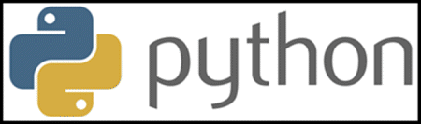
Introduction to
Python is a widely used programming language that offers several unique features and advantages compared to languages like Java and C++.
Python is an object-oriented programming language created by Guido Rossum in 1989. It is ideally designed for rapid prototyping of complex applications.
Python is one of the most popular programming languages. Although it is a general-purpose language, it is used in various areas of applications such as Machine Learning, Artificial Intelligence, web development, IoT, and more.
Many large companies use the Python programming language, including NASA, Google, YouTube, BitTorrent, etc.

Slide 3
Why learn Python?
Python provides many useful features to the programmer:-
Easy to use and Read - Python's syntax is clear and easy to read, making it an ideal language for both beginners and experienced programmers
Dynamically Typed - The data types of variables are determined during run-time. We do not need to specify the data type of a variable during codes
High-level - High-level language means human readable code
Garbage Collected - Memory allocation and de-allocation are automatically managed. Programmers do not specifically need to manage the memory

Slide 4
Why learn Python?
Cross-platform Compatibility - Python can be easily installed on Windows, macOS, and various Linux distributions.
Rich Standard Library - Python comes with several standard libraries that provide ready-to-use modules and functions.
Open Source - Python is an open-source, cost-free programming language.
GUI Programming Support: Python provides several GUI frameworks, such as Tkinter to allowing developers to create desktop applications easily.
Wide Range of Libraries and Frameworks: Python has a vast collection of libraries and frameworks, such as NumPy, Pandas, Django, and Flask, that can be used to solve a wide range of problems.

Slide 5
Application area of python
Data Science: Data Science is a vast field, and Python is an important language for this field because of its simplicity, ease of use, and availability of powerful data analysis and visualization libraries like NumPy, Pandas, and Matplotlib.
Desktop Applications: Tkinter are useful libraries that can be used in GUI - Graphical User Interface-based Desktop Applications. There are better languages for this field, but it can be used with other languages for making Applications.
Mobile Applications: While Python is not commonly used for creating mobile applications, it can still be combined with frameworks like Kivy or BeeWare to create cross-platform mobile applications.

Slide 6
Application area of python
Web Applications: Python is commonly used in web development on the backend with frameworks like Django and Flask and on the front end with tools like JavaScript HTML and CSS.
Machine Learning: Python is widely used for machine learning due to its simplicity, ease of use, and availability of powerful machine learning libraries
Computer Vision or Image Processing Applications: Python can be used for computer vision and image processing applications through powerful libraries such as OpenCV and Scikit-image.
Gaming: Python has libraries like Pygame, which provide a platform for developing games using Python.
DevOps: Python is widely used in DevOps for automation and scripting of infrastructure management, configuration management, and deployment processes

Slide 7
Python Popular Frameworks and Libraries
Python has wide range of libraries and frameworks widely used in various fields such
Web development (Server-side) - Django Flask, Pyramid, CherryPy
GUIs based applications - Tkinter, PyGTK, PyQt, PyJs, etc.
Machine Learning - TensorFlow, PyTorch, Scikit-learn, Matplotlib, Scipy, etc.
SQLAlchemy: a library for working with SQL databases
NLTK: a library for natural language processing
Pygame: a library for game development
Pytest: a testing framework for Python Django
REST framework: a toolkit for building RESTful API

Slide 8
Advantages of Python language
Cross-Platform Compatibility
Strong Community Support
Integration and Extensibility
Scalability and Performance
Versatility and Flexibility

Slide 9
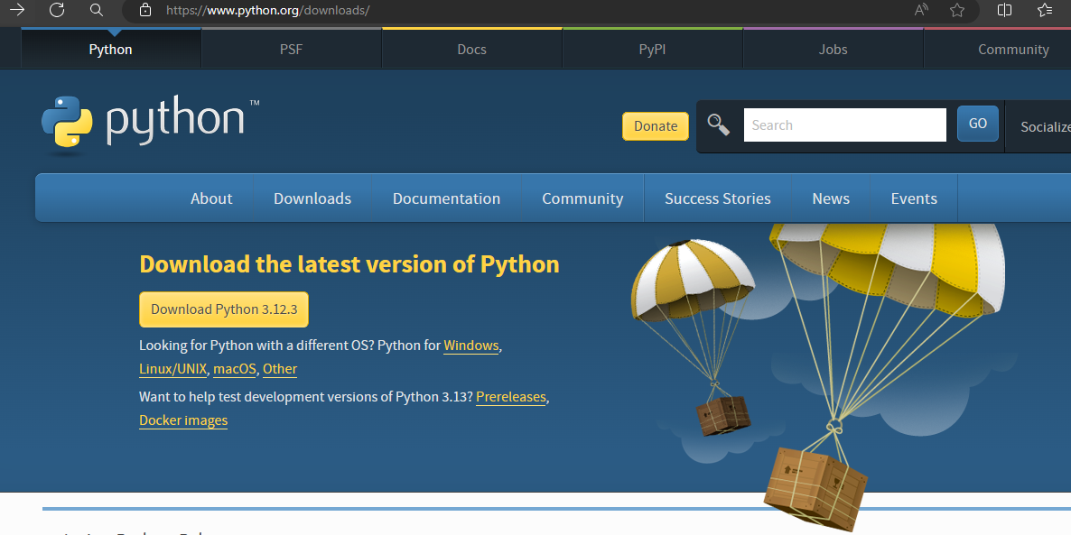
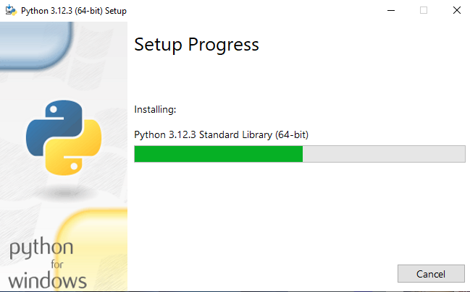
How to install Python
Visit the official website of Python https://www.python.org/downloads/ and choose your version.
Once the download is completed, run the .exe file to install Python. Now click on Install Now.

Slide 10
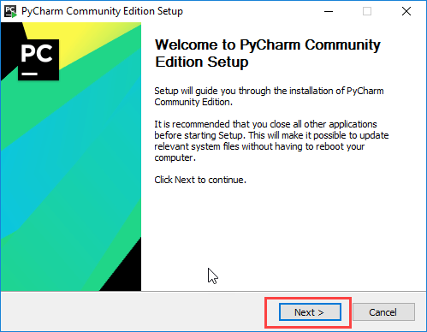
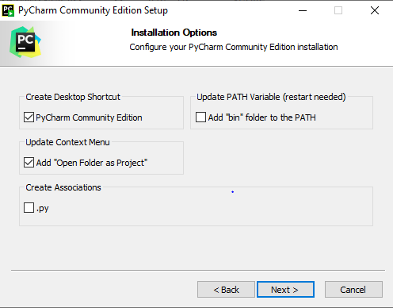
How to install Python IDE
1. PyCharm is a cross-platform editor developed by JetBrains. Pycharm provides all the tools you need for productive Python development.
visit the website https://www.jetbrains.com/pycharm/download/ and Click the “DOWNLOAD” link under the Community Section.

Slide 11
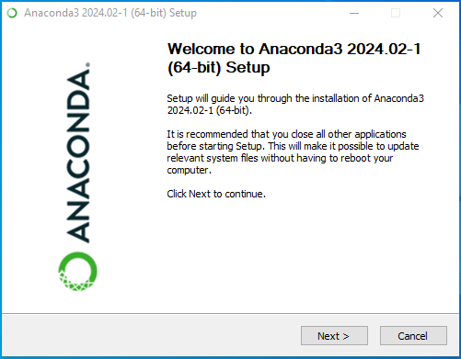
How to install Python IDE
2. Anaconda is a free and open source distribution of the Python and R programming languages for large-scale data processing, predictive analytics, and scientific computing.
An anaconda is an open-source free path that allows users to write programming in Python language. The anaconda is termed by navigator as it includes various applications of Python such as Spyder, Vs code, Jupiter notebook, PyCharm
How to install anaconda: Go to https://www.anaconda.com/download/ and download Anaconda
To check anaconda is installed
Go to anaconda command prompt then
write the following
conda info --envs

Slide 12
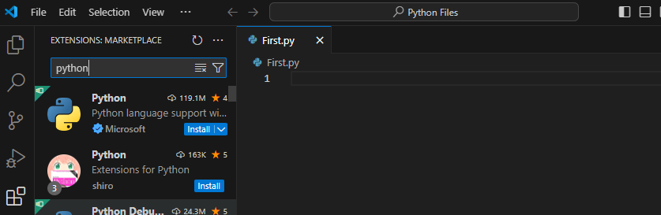
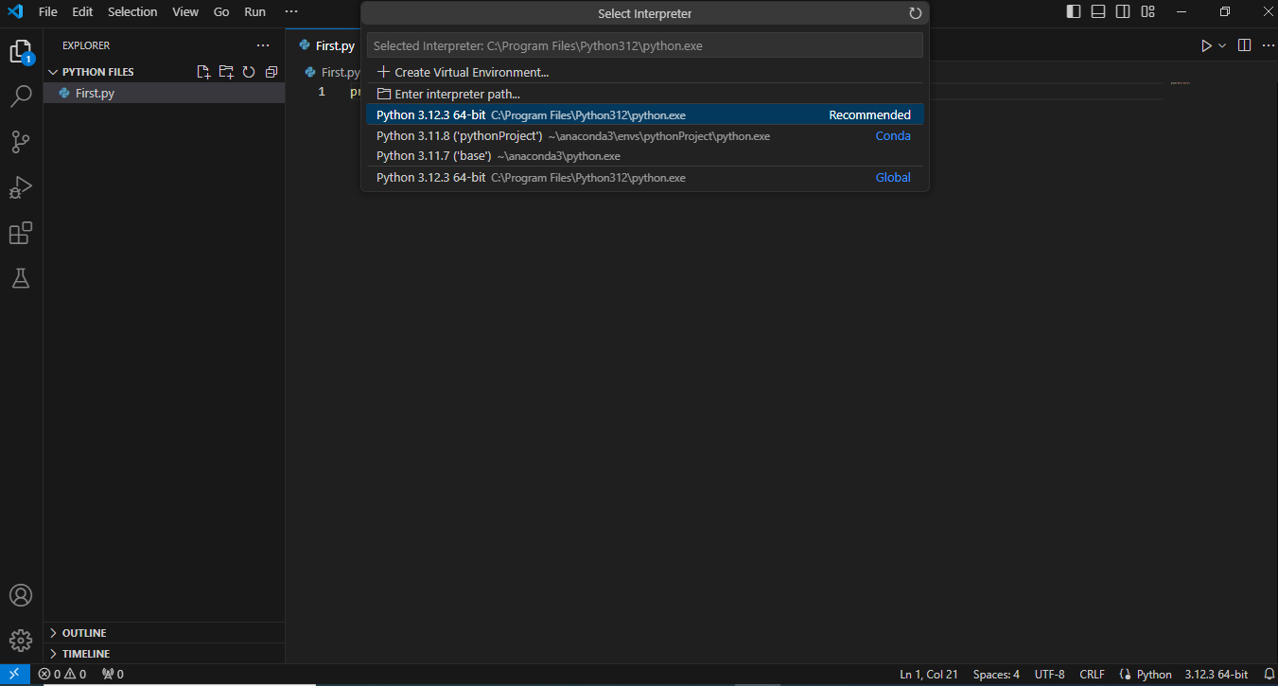
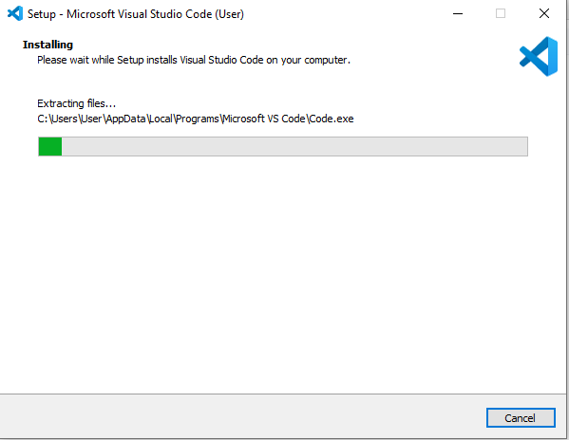
How to install Python IDE
3. Visual Studio Code is a free open source text editor by Microsoft. VS Code is available for Windows, Linux, and macOS
How to install Visual Studio Code: Go to https://code.visualstudio.com and download visual studio code

Slide 13
Basic elements of Python:
Python Basic Syntax:-
There is no use of curly braces or semicolons in Python programming language. It is an English-like language.
But Python uses indentation to define a block of code. Indentation is nothing but adding whitespace before the statement.
Python is a case-sensitive language, which means that uppercase and lowercase letters are treated differently.
In Python, comments can be added using the '#' symbol. Any text written after the '#' symbol is considered a comment.
Following triple-quoted string is also ignored by Python interpreter and can be used as a multiline comments: example ''' This is a
multiline comment. '''

Slide 14
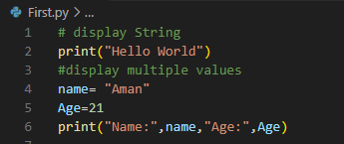
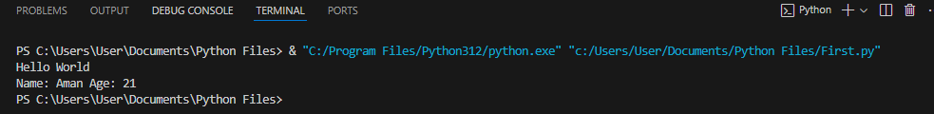
Basic elements of Python:
Python print() Function
Python print() function is used to display output to the console or terminal.
It allows us to display text, variables and other data in a human readable format.
Output
Python accepts single ('), double (") and triple (''' or """) quotes to denote string literals, as long as the same type of quote starts and ends the string.

Slide 15
Python Variables:
Python Variables
Python variables are the reserved memory locations used to store values with in a Python Program.
When you create a variable you reserve some space in the memory
Based on the data type of a variable, Python interpreter allocates memory and decides what can be stored in the reserved memory

Slide 16
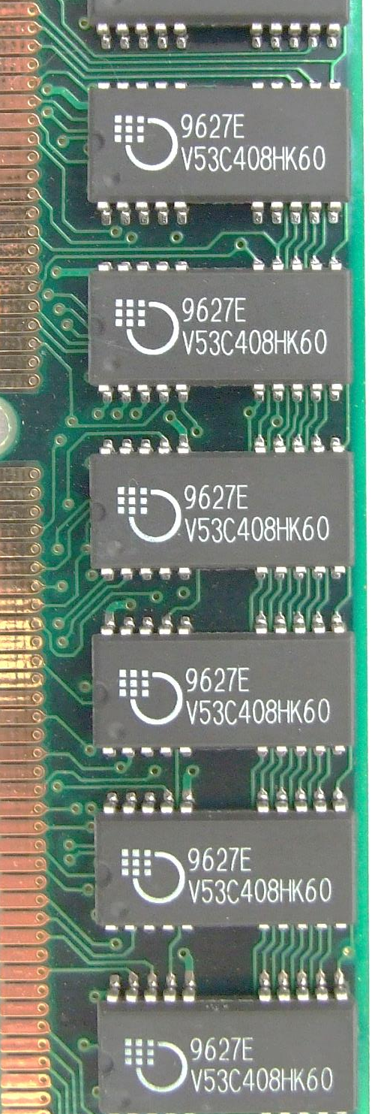
Python Variables:
m
A name associated with an object
Assignment used for binding
m = 64
c = ‘students’;
f = 3.1416;
Variables can change their bindings
f = 2.7183;
64
students
c
3.1416
f
2.7183

Slide 17
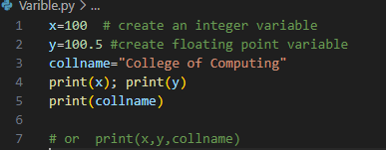

Python Variables:
Python variables do not need explicit declaration to reserve memory space or you can say to create a variable.
A Python variable is created automatically when you assign a value to it. The equal sign (=) is used to assign values to variables.
Example output

Slide 18
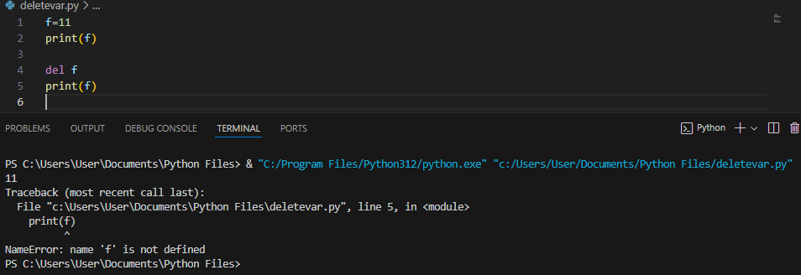

Deleting Python Variables:
You can delete the reference to a number object by using the del statement. The syntax of the del statement is
del var name
Example
You can get the data type of a Python variable using the python built-in function type() as follows. Output
Example: Printing Variables Type
x = "Zara“
y = 10
z = 10.10
print(type(x))
print(type(y))
print(type(z))

Slide 19
Python Variables - Multiple Assignment:
Python allows to initialize more than one variables in a single statement.
In example A , three variables have same value.
Example A Output Output
Rules for Python Variables:
A variable name must start with a letter or the underscore character
A variable name cannot start with a number or any special character like $, (, * % etc.)
A variable name can only contain alpha-numeric characters and underscores (A-z, 0-9, and _ )
Python variable names are case-sensitive which means Name and NAME are two different variables in Python.
Python reserved keywords cannot be used naming the variable.
a=b=c=10
print (a,b,c)
a,b,c = 10,20,30
print (a,b,c)

Slide 20
Python Basics - Whitespace:
Whitespace is meaningful in Python: especially indentation and placement of newlines
Use a newline to end a line of code
Use \ when must go to next line prematurely
No braces {} to mark blocks of code, use consistent indentation instead
Colons start of a new block in many constructs, e.g. function definitions, then clauses

Slide 21
Constants in Python
Python constant
Python doesn't have any formally defined constants, However you can indicate a variable to be treated as a constant by using all-caps names with underscores
For example, the name PI_VALUE indicates that you don't want the variable redefined or changed in any way.
In Python, constants are usually declared and assigned in a module (a new file containing variables, functions, etc which is imported to the main file).
Create a constant.py: | Create a main.py:
# declare constants PI = 3.14 GRAVITY = 9.8 | # import constant file we created above import constant print(constant.PI)# prints 3.14 print(constant.GRAVITY # prints 9.8

Slide 22
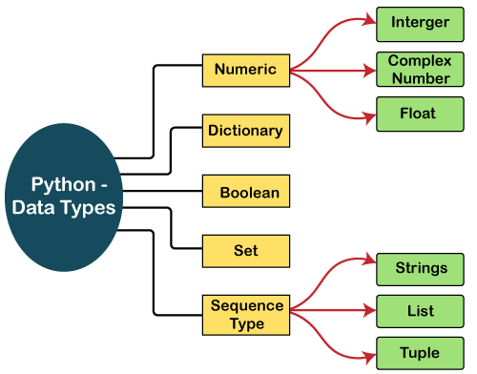
Data Types in Python:
A data type represents a kind of value and determines what operations can be done on it. It defines what type of data we are going to store in a variable.

Slide 23
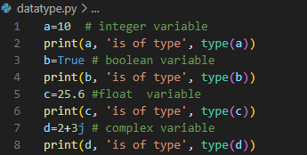

Python Numeric Data Type
- Python supports different numerical types and each of them have built-in classes in Python library like int, bool, float and complex
- We can use the type() function to know which class a variable or a value belongs to.
output

Slide 24
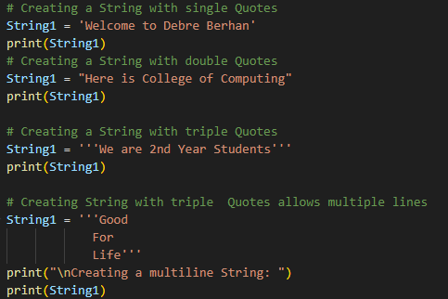
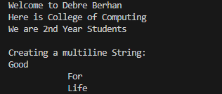
Python Sequence Data Type
Sequence is a collection data type. It is an ordered collection of items. Items in the sequence have a positional index starting with 0. It is conceptually similar to an array in C++.
1. Python String Data Type
Python string is a sequence of one or more Unicode characters, enclosed in single, double or triple quotation marks.
output

Slide 25

Python Sequence Data Type
Strings in Python are “immutable” which means they can not be changed after they are created(you always produce a new string object of the same type, rather than mutating an existing string)
Some other immutable data types are integers, float, boolean, etc
Example: output
name = "Computing"
name[0] = 'T'
print(name)

Slide 26
Python Sequence Data Type
A string is a non-numeric data type. Obviously, we cannot perform arithmetic operations on it. However, operations such as slicing and concatenation can be done.
Python's str class defines a number of useful methods for string processing. Subsets of strings can be taken using the slice operator ([ ] and [:] ) with indexes starting at 0 in the beginning of the string and working their way from -1 at the end.
The plus (+) sign is the string concatenation operator and the asterisk (*) is the repetition operator in Python.
Notes:
* symbol to represent multiplication, but when the operand on the left side of the * is a list, it becomes the repetition operator. The repetition operator makes multiple copies of a list and joins them all together.

Slide 27
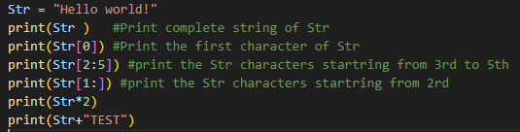
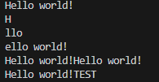
Python Sequence Data Type
Example of String Data Type
Output

Slide 28


Python Sequence Data Type
2. Python List Data Type
A Python list contains items separated by commas and enclosed within square brackets ([]).
Python lists are similar to arrays in C++. One difference between them is that:
They allow us to store multiple items in a single variable
List declaration :placing elements inside square brackets [], separated by commas.
Example Output

Slide 29
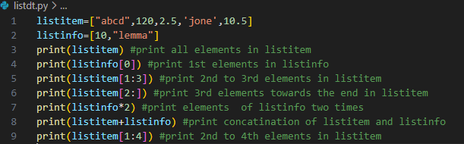
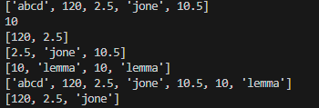
Python Sequence Data Type
Python List Data Type
The values stored in a Python list can be accessed using the slice operator ([ ] and [:]) with indexes starting at 0 in the beginning of the list and working their way to end -1. The plus (+) sign is the list concatenation operator, and the asterisk (*) is the repetition operator.
Output

Slide 30


Python Sequence Data Type
3. Python Tuple Data Type
A Python tuple consists of a number of values separated by commas. Unlike lists, however, tuples are enclosed within parentheses (...)
A tuple is a collection of data similar to a python list The only difference is that we cannot modify a tuple once it has been created
A tuple is also a sequence, hence each item in the tuple has an index referring to its position in the collection. The index starts from 0.
Tuple declaration :placing elements inside parentheses(), separated by commas
Example Output

Slide 31
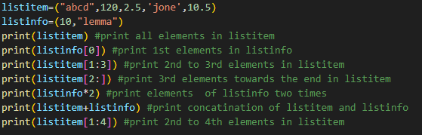
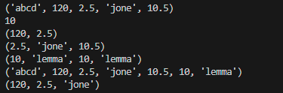
Data Types in Python:
Python Tuples Data Type :- The main differences between lists and tuples are:
Lists are enclosed in brackets ( [ ] ) and their elements and size can be changed that means lists are mutable,
while tuples are enclosed in parentheses ( ( ) ) and cannot be updated (immutable). Tuples can be thought of as read-only lists Output
Output

Slide 32
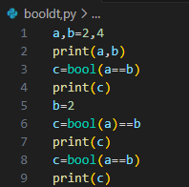

Python Boolean Data Types
Python Boolean type is one of built-in data types which represents one of the two values either True or False.
Python bool() function allows you to evaluate the value of any expression and returns either True or False based on the expression.
Output

Slide 33
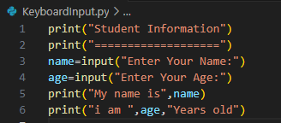
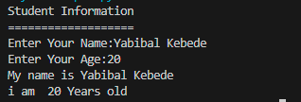
Python Input/output operations
Python provides us with two built-in functions to read the input from the keyboard. The input () Function The raw_input () Function
When the interpreter encounters input() function, it waits for the user to enter data from the standard input stream (keyboard)
Output

Slide 34
Taking Numeric Input in Python
Python always read the user input as a string.
If there is an input type int or float numbers and used for some operation with out casting to respective datatype error will be occurred
To overcome such problem, we shall use type casting:
int():It converts a string object to an integer.
float(): It converts a string object to an floating point
Complex(): It converts a string object to complex number
Example:
write a Python program that inputs width and height of a rectangle from the user and display the area.

Slide 35


Taking Numeric Input in Python
Let us write a Python code that accepts integer value of width and height of a rectangle from the user and computes the area.)
Sample output

Slide 36

Methods to Take multiple inputs from user and format output
Python user can take multiple values or inputs in one line.
Methods to Take multiple inputs from user
Using split() method: It breaks the given input by the specified separator. If a separator is not provided then any white space is a separator. Generally, users use a split() method to split a Python string but one can use it in taking multiple inputs.
Example: output:
Using map() with split():
Using List comprehension :

Slide 37
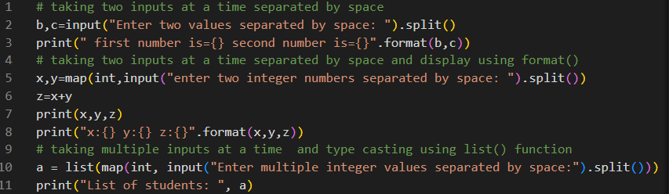
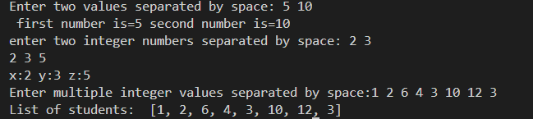
Example: multipleinput.py
Methods to Take multiple inputs from user
Sample output:

Slide 38
Escape sequences
Escape sequences are special characters that represent non-printing characters
Example:
\a - bell (beep)
\b – backspace
\n – newline
\t – tab
\’ – single quote
\” – double quote
\v - vertical tab

Slide 39
The operator is a symbol that performs a specific operation between two operands. Python also has some operators
Operators in Python
+ | - | * | // | / | % | **
Arithmetic
Comparison
Assignment
Logical
Bitwise
Membership
Identity
== | != | > | < | >= | <=
= | += | -= | *= | //= | /= | %= | **=
and | or | not
& | | | ^ | ~ | >> | <<
in | not in
is | is not

Slide 40

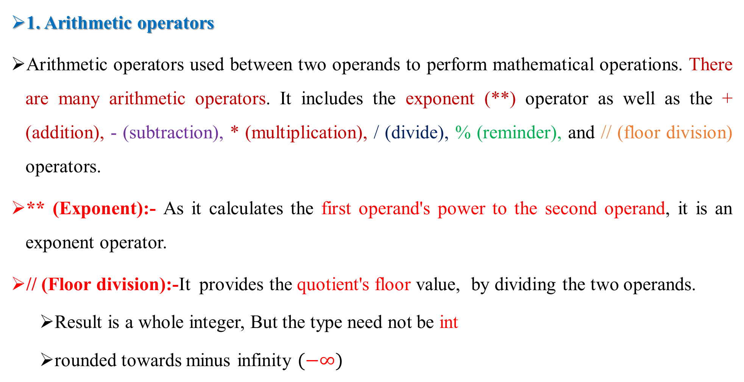
Operators in Python
1. Arithmetic operators
Arithmetic operators used between two operands to perform mathematical operations. There are many arithmetic operators. It includes the exponent (**) operator as well as the + (addition), - (subtraction), * (multiplication), / (divide), % (reminder), and // (floor division) operators.
** (Exponent):- As it calculates the first operand's power to the second operand, it is an exponent operator.
// (Floor division):-It provides the quotient's floor value, by dividing the two operands.
Result is a whole integer, But the type need not be int
rounded towards minus infinity $(−∞)$

Slide 41
Operators in Python
Operator | Operation | Example
+ | Addition | 4 +5 = 9
- | Subtraction | 7 -3 = 4
* | Multiplication | 5 * 3 =15
/ | Division | 9 / 2 = 4.5
// | Floor Division | 9 // 2 = 4
% | Modulo | 7 % 2 = 1
** | Power | 2** 3 = 8

Slide 42
Operators in Python
2. Comparison operator
Comparison operators compare two values/variables and return a Boolean result: True or False. The example of comparison operators are ==, !=, <=, >=, >, <.
Operator | Meaning | Example
== | Is Equal To | 3 == 5 gives us False
!= | Not Equal To | 3 != 5 gives us True
> | Greater Than | 3 > 5 gives us False
< | Less Than | 3 < 5 gives us True
>= | Greater Than or Equal To | 3 >= 5 give us False
<= | Less Than or Equal To | 3 <= 5 gives us True

Slide 43
Operators in Python
3. Assignment Operators
Using the assignment operators, the right expression's value is assigned to the left operand. There are some examples of assignment operators like =, +=, -=, *=, %=, **=,
Operator | Name | Example
= | Assignment Operator | a = 7
+= | Addition Assignment | a += 1 # a = a + 1
-= | Subtraction Assignment | a -= 3 # a = a - 3
*= | Multiplication Assignment | a *= 4 # a = a * 4
/= | Division Assignment | a /= 3 # a = a / 3
%= | Remainder Assignment | a %= 10 # a = a % 10
**= | Exponent Assignment | a **= 10 # a = a ** 10

Slide 44
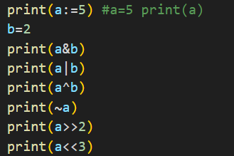

Operators in Python
4. Bitwise Operators
The two operands' values are processed bit by bit by the bitwise operators. The examples of Bitwise operators are bitwise OR (|), bitwise AND (&), bitwise XOR (^), negation (~), Left shift (<<), and Right shift (>>).
The result of AND is 1 only if both bits are 1.
The result of OR is 1 if any of the two bits is 1.
The result of XOR is 1 if the two bits are different.
shift (<<) takes two numbers, left shifts the bits of the first
operand, the second operand decides the number of places to shift. Output
Right shift (>>) takes two numbers, right shifts the
bits of the first operand, the second operand decides the number of places to shift.
Bitwise NOT ( ~ ) is the only unary bitwise operator. Since take only one operand. X=-X-1

Slide 45


Operators in Python
5. Logical Operators
Logical operators are used to check whether an expression is True or False. They are used in decision-making.
Example:
Output:
Operator | Example | Description
and | a and b | Logical AND: True only if both the operands are True
or | a or b | Logical OR: True if at least one of the operands is True
not | not a | Logical NOT: True if the operand is False and vice-versa.

Slide 46
Operators in Python
6. Membership Operators
In Python, in and not in are the membership operators.
The membership of a value inside a Python data structure can be verified using Python membership operators.
They are used to test whether a value or variable is found in a sequence (string, list, tuple, set and dictionary).
The result is true if the value is in the data structure; otherwise, it returns false.
In a dictionary, we can only test for the presence of a key, not the value.

Slide 47
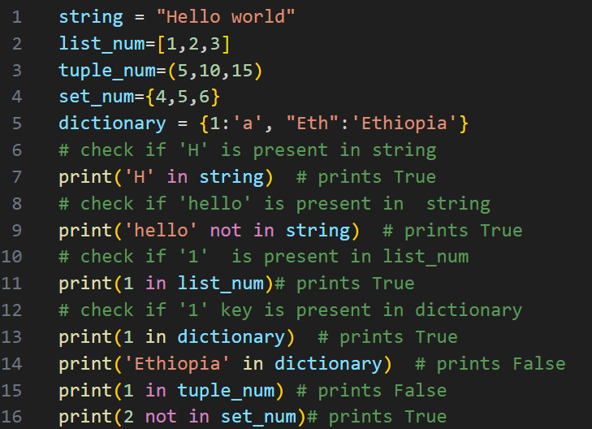
Operators in Python
6. Membership Operators
Example:

Slide 48
In
Operators in Python
7. Identity Operators
In Python, is and is not are used to check if two values are located at the same memory location.
It's important to note that having two variables with equal values doesn't necessarily mean they are identical.
Operator | Meaning | Example
is | True if the operands are identical (refer to the same object) | x is y
is not | True if the operands are not identical (do not refer to the same object) | x is not y

Slide 49
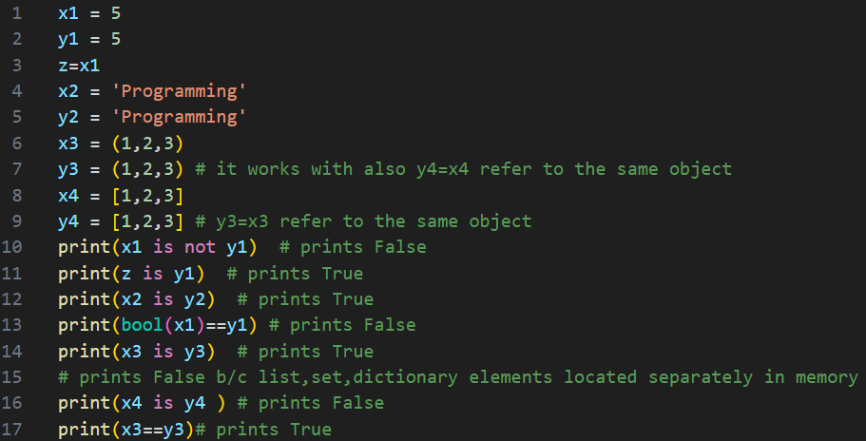
In
Operators in Python
Example:

Slide 50
Precedence and Associativity of Operators in Python
1 | *,, /, //, % | Multiplication, matrix, division, floor division, remainder | Left to right
2 | +,- | Addition and subtraction | Left to right
3 | <<, >> | Shifts | Left to right
4 | & | Bitwise AND | Left to right
5 | ^ | Bitwise XOR | Left to right
6 | | | Bitwise OR | Left to right
Example:- 100 + 200 / 10 - 3 * 10

Slide 51
Debugging and Errors in Python
Debugging means the complete control over the program execution. Developers use debugging to overcome program from any bad issues.
debugging is a healthier process for the program and keeps the diseases bugs far away.
Python also allows developers to debug the programs using pdb module that comes with standard Python by default.
We just need to import pdb module in the Python script and use pdb.set_trace(). Using pdb module, we can set breakpoints in the program to check the current status

Slide 52
Errors in Python
Errors are the mistakes or faults performed by the user which results in abnormal working of the program.
However, we cannot detect programming errors before the compilation of programs. The process of removing errors from a program is called Debugging
Errors in Python can be broadly classified into three categories:- Syntax Errors, Runtime Errors, and Logical Errors.
Syntax errors :- occurs when we do not use properly defined syntax
Example:
Incorrect arguments/parameter | Using Python keywords as variable names.
Indentation | Mixing single and double quotes improperly in a string Forgetting a colon at the end of an if statement
Use of undefined variables | Mismatched parentheses, like print("Hello world"

Slide 53
Errors in Python
2. Runtime Errors
Error does not appear until after the program has started running
These errors are also called exceptions because they usually indicate that something exceptional (and bad) has happened in program execution. Example:
Division by zero
Performing an operation on incompatible types
Accessing a list element, dictionary value or object attribute which doesn’t exist
Trying to access a file which doesn’t exist

Slide 54
Errors in Python
3. Logical/Semantic Errors
If there is a semantic error in your program, it will run successfully in the sense that the computer will not generate any error messages, but it will not do the right thing.
The program runs without issues, but it doesn't achieve the intended results.
The problem is that the program you wrote is not the program you wanted to write. The meaning of the program (its semantics) is wrong.
Identifying semantic errors can be tricky because it requires you to work backward by looking at the output of the program and trying to figure out what it is doing.
Example: display the sum of two numbers(10,5)
x,y=10,5
sum=x*y
print(sum)

Slide 55

Conditional, Looping and Control Statements
Introduction:
In order to write useful programs, we almost always need the ability to check conditions and change the behavior of the program accordingly
x=10
if(x>0):
print("x is positive")
The Boolean expression after if is called the condition. If it is true, then the indented statement gets executed. If not, nothing happens
if statements have the same structure as function definitions: a header followed by an indented body. Statements like this are called compound statements.
There is no limit on the number of statements that can appear in the body, but there has to be at least one. Occasionally, it is useful to have a body with no statements. In that case, you can use the pass statement, which does nothing.

Slide 56
Conditional Statements
Conditional Statement in Python perform different computations or actions depending on whether a specific Boolean constraint evaluates to true or false
Decision making is the most important aspect of almost all the programming languages. As the name implies, decision making allows us to run a particular block of code for a particular decision. Here, the decisions are made on the validity of the particular conditions.
Statement | Description
if | The if statement is used to test a specific condition. If the condition is true, a block of code (if-block) will be executed.
if – else | The if-else statement is similar to if statement except the fact that, it also provides the block of the code for the false case of the condition to be checked.
Nested if elif | Nested if statements enable us to use if ? else statement inside an outer if statement. The elif statement enables us to check multiple conditions and execute the specific

Slide 57
Indentation in python
Indentation in Python
For the ease of programming and to achieve simplicity, python doesn't allow the use of parentheses for the block level code. In Python, indentation is used to declare a block.
If two statements are at the same indentation level, then they are the part of the same block.
Generally, four spaces are given to indent the statements which are a typical amount of indentation in python.
Indentation is the most used part of the python language since it declares the block of code.
All the statements of one block are intended at the same level indentation.

Slide 58
Indentation
Indentation is important in Python
grouping of statement (block of statements)
no explicit braces, e.g. { }, to group statements
x,y = 6,10
if x < y:
print (x)
else:
print (y)
print (‘is the min’)
Run the program
x
y
6
10
skipped
Output
6

Slide 59
The If statement(no else!)
General form of the if statement
Execution of if statement
First the expression is evaluated.
If it evaluates to a true value, then S1 is executed and then control moves to the S2.
If expression evaluates to false, then control moves to the S2 directly.
NB: Python interprets non-zero values as True. None and 0 are interpreted as False.
if boolean-expr :
Statement 1(S1)
Statement 2(S2)
true
false
S1
S2

Slide 60
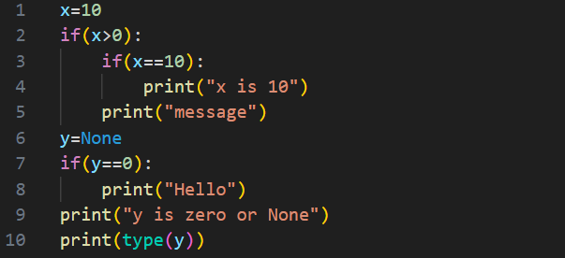

The If statement(no else!)
Example:
Output:

Slide 61
The If-else statement
General form of the if-else statement
Execution of if-else statement
First the expression is evaluated.
If it evaluates to a true value, then S1 is executed and then control moves to S3.
If expression evaluates to false, then S2 is executed and then control moves to S3.
S1/S2 can be blocks of statements!
if boolean-expr :
Statement1(S1)
else:
Statement2(S2)
Statement3(S3)
true
false
S1
S2
S3

Slide 62
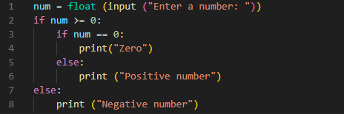

Nested if, if-else statement
We can have a if...else statement inside another if....else statement
Any number of these statements can be nested inside one another.
Indentation is the only way to figure out the level of nesting.
Example : input a number to check if the number is positive or negative or zero and display appropriate message
Syntax:
if condition:
if condition:
statement
else:
statement
else:
if condition :
statement
else:
statement

Slide 63
The elif statement
A special kind of nesting is the chain of if-else-if-else-… statements
The elif is short for else if. It allows us to check for multiple expressions
If the condition for if is False, it checks the condition of the next elif block and so on.
If all the conditions are False, the body of else is executed.
Only one block among the several if...elif...else blocks is executed according to the condition.
if condition1:
s1
elif condition2:
s2
elif condition3:
s3
elif …
else
last-block-of-statement(Slast)
true
false
S1
true
false
S2
true
false
Slast
S3

Slide 64
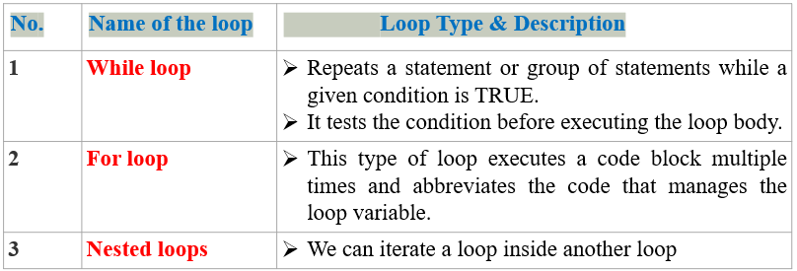
Looping Statements
In general, statements are executed sequentially
There may be a situation when you need to execute a block of code several number of times.
Loop statements allow us to execute a statement or group of statements multiple time
Python programming language provides the following types of loops to handle looping requirements.

Slide 65
while loop Statements
The while loop in Python is used to iterate over a block of code as long as the test expression (condition) is true.
We generally use while loop when we don't know the number of times to iterate beforehand.
The body starts with indentation and the first unindented line marks the end.
Python interprets any non-zero value as True. None and 0 are interpreted as False.
while (expression):
S1
S2
FALSE
Evaluate expression
If TRUE then
execute statement1
goto step 1.
If FALSE then execute statement2.
expression
TRUE
S1
S2

Slide 66
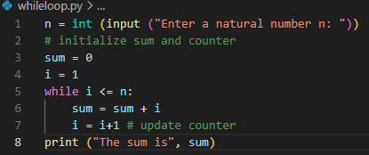

while loop Statements
Example:
1. write a Program that display the sum of the following natural numbers series
sum = 1+2+3+...+n , take n as input from the user
2. Write a program that accepts a positive number from the keyboard and determine whether the number is prime or not?
output:

Slide 67
Python while loop using List
Len() function
It's important to note that the indexing of elements in a list starts from 0, so the length of a list is always greater than or equal to 0.
The len() function is efficient and commonly used for iterating over lists or performing operations based on the size of a list
Example:- Write a python program to find the sum of the given list using while loop? numbers = [3, 5, 23, 6, 5, 1, 2, 9, 8]
numbers = [3, 5, 23, 6, 5, 1, 2, 9, 8]
sum = 0
i=0
while i < len(numbers):
sum =sum+ numbers[i]
i += 1
print("Sum of each element:", sum)

Slide 68
Python for loop
Python frequently uses the Loop to iterate over iterable objects like lists, tuples, and strings.
Iterating over a sequence is called traversal.
for loops are used when a section of code needs to be repeated a certain number of times.
Passing the whitespace to the end parameter (end=' ') indicates that the end character has to be identified by whitespace and not a newline.
The range () function:
We can also define the start, stop and step size as range (start, stop, step_size).
range(start, end) is equivalent to range(start, end, 1)
range(end) is equivalent to range(0, end)
step_size defaults to 1, start to 0 and stop is end of object if not provided
syntax
for value in range():
statement
syntax
for value in sequence:
statement

Slide 69




Python for loop
Example:- write a python program to print a number from print 1 to 10 even using for loop.
for i in range(11):
print(i,end=" ")
for i in range(1,11):
print(i,end=" ")
for i in range(1,11,2):
print(i)
for i in range(2,11,2):
print(i)

Slide 70
for loop using list
The rang() function does not store all the values in memory; it would be inefficient. So, it remembers the start, stop, step size and generates the next number on the go.
To force this function to output all the items, we can use the function list(). Example: print(range(10)) print(list(range(10))) print (list (range (2, 8))) print (list (range (2, 20, 3))) Output: range (0, 10) [0, 1, 2, 3, 4, 5, 6, 7, 8, 9] [2, 3, 4, 5, 6, 7] [2, 5, 8, 11, 14, 17]

Slide 71
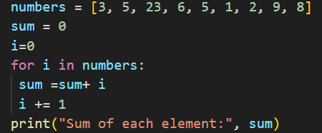
For loop using list
Write a python program to find the sum of each element of the list using for loop? numbers = [3, 5, 23, 6, 5, 1, 2, 9, 8]
Since instead of range just replace list (numbers) Output
Solution:-
syntax
for value in sequence:
statement

Slide 72
Control Statements
Control statements used to control the order of execution of the program based on the values and logic
Python supports the following control statements
No. | Control Statement & Description
1 | Break statement:- Terminates the loop statement and transfers execution to the statement immediately following the loop.
2 | Continue statement :- Causes the loop to skip the remainder of its body and immediately retest its condition prior to reiterating.
3 | Pass statement :- The pass statement in Python is used when a statement is required syntactically but you do not want any command or code to execute.

Slide 73


Python break statement
Break is commonly used to break the loop for a given condition.
It is useful when we want to terminate the loop as soon as the condition is fulfilled instead of doing the remaining iterations Syntax
Write the output of the following program??
Loop statements
break;
my_str = "python"
for char in my_str:
if char == 'o':
break
print(char)
for i in range(1,10,2):
while i==8:
break
print(i)
numbers = [3, 5, 23, 6, 5, 1, 2, 9, 8]
for char in numbers:
if char == 1:
break
print(char)
for i in range(1,10,2):
while i==7:
print(i)
break

Slide 74


Python continue statement
Python continue keyword is used to skip the remaining statements of the current loop and go to the next iteration
Write the output of the following program??
Loop statements
continue;
for i in range(1,10,2):
while i==8:
continue
print(i)
my_str = "python"
for char in my_str:
if char == 'o':
continue
print(char)
infinitely displaying 7
for i in range(1,10,2):
while i==7:
print(i)
continue
numbers = [3, 5, 23, 6, 5, 1, 2, 9, 8]
for char in numbers:
if char == 1:
continue
print(char)

Slide 75
Python pass statement
We can use the pass statement as a placeholder when unsure of the code to provide. Therefore, the pass only needs to be placed on that line
Syntax:
Write the output of the following program??
Loop statements
pass;
sequence = {"Python", "program", "Statement", 22,10,"Placeholder“,40}
for value in sequence:
if value == "program":
pass
else:
print( value)
sequence = [4,7,21,7,90,54]
for value in sequence:
if value == 7:
pass
else:
print(value)

Slide 76
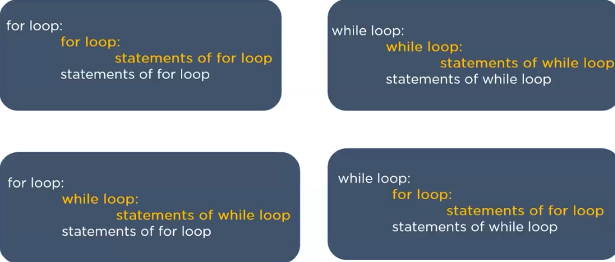
Python nested loop
In python nested loop is a loop inside another loop. Syntax
Outer loop
inner loop
statement of inner loop
statement of outer loop

Slide 77

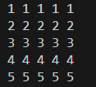
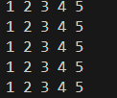

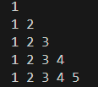
Python nested loop
Example:- Write the output of the following python program
for i in range(1,6):
for j in range(1,6):
print("*",end=" ")
print()
for i in range(1,6):
for j in range(1,7-i):
print(j, end=" ")
print()
for i in range(1,6):
for j in range(1,6):
print(i,end=" ")
print()
for i in range (1,6):
for j in range(1,i+1):
print(j,end=" ")
print(" ")
for i in range(1,6):
for j in range(1,6):
print(j,end=" ")
print()

Slide 78
Introduction
Python Function
One of the core principles of any programming language is, "Don’t Repeat Yourself".
If you have an action that should occur many times, you can define that action once and then call that code whenever you need to carry out that action
In Python, a function is a group of related statements that performs a specific task.
Functions help break our program into smaller and modular chunks.
As our program grows larger and larger, functions make it more organized and manageable. Furthermore, it avoids repetition and makes the code reusable
Function are not run in a program until they are “called” or “invoked”in a program
As you already know, Python gives you many built-in functions like print(). but you can also create your own functions. These functions are called user-defined functions.

Slide 79
Introduction
Python Function
One of the core principles of any programming language is, "Don’t Repeat Yourself".
If you have an action that should occur many times, you can define that action once and then call that code whenever you need to carry out that action
In Python, a function is a group of related statements that performs a specific task.
This Functions help break our program into smaller and modular chunks.
As our program grows larger and larger, functions make it more organized and manageable.It avoids repetition and makes the code reusable
Function are not run in a program until they are “called” or “invoked”in a program

Slide 80
Python Function
There are two kinds of functions in Python:
Built-in/standard functions that are provided as part of Python - print(), input(), type(), float(), int() ...
Custom/user-defined functions: Functions that we define ourselves and then use
We treat function names as “new” reserved words (i.e., we avoid them as variable names)

Slide 81
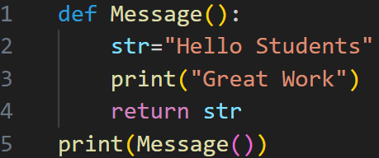

Function Definition
In Python a function is some stored reusable code that takes parameter(s) as input, does some computation, and then returns a result or results
We define a function using the def reserved word
We call/invoke the function by using the function name, parentheses, and arguments in an expression
Syntax: def functionname( parameters ): “““Documentation String””” statements return expression | Example: output

Slide 82
def maxi (a, b):
‘’’return maximum among a and b’’’
if (a > b):
return a
else:
return b
keyword
2 parameters
a and b
(formal args)
Function Name
x = maxi(6, 4)
Body of thefunction,
indented with reference to the
def keyword
Call to the function.
Actual args are 6 and 4.
Documentation comment
(docstring), type
help <function-name>
on prompt to get help for the function

Slide 83
Functions without returns
Python Function
All functions in Python have a return value, even if no return line inside the code
Functions without a return , return the special value None
None is a special constant in the language
None is used like NULL, void, or nil in other languages
None is also logically equivalent to False
The interpreter’s REPL doesn’t print None
Notes:
REPL is an acronym for Read, Evaluate, Print, and Loop.

Slide 84
Function overloading? No.
Python Function
There is no function overloading in Python
Unlike C++, a Python function is specified by its name alone
The number, order, names, or types of arguments cannot be used to distinguish between two functions with the same name
Two different functions can’t have the same name, even if they have different arguments

Slide 85
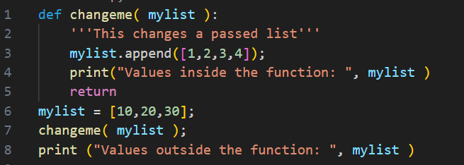
Pass by reference vs value
Python Function
All parameters (arguments) in the Python language are passed by reference. It means if you change what a parameter refers to within a function, the change also reflects back in the calling function. For example:
So this would produce following result:
Values inside the function: [10, 20, 30, [1, 2, 3, 4]]
Values outside the function: [10, 20, 30, [1, 2, 3, 4]]

Slide 86
Python Function
Pass by reference vs value
There is an example where argument is being passed by reference but inside the function, but the reference is being over-written.
def changeme( mylist ):
mylist=[1,2,3,4]
print("Values inside the function: ", mylist )
return
mylist = [10,20,30];
changeme( mylist )
print ("Values outside the function: ", mylist )
The parameter mylist is local to the function changeme. Changing mylist within the function does not affect mylist. The function accomplishes nothing and finally this would produce following result:
Values inside the function: [1, 2, 3, 4]
Values outside the function: [10, 20, 30]

Slide 87
Pass By Value vs. Returning a Value
Python Function
Consider the following code
def increment_func(x):
x = x + 1
return x
x = 1
x = increment_func(x)
print(x)
def increment_func(x):
x = x + 1
x = 1
increment_func(x)
print(x)
Run
Run
1
2

Slide 88


Python Function
Function Arguments:
A function by using the following types of formal arguments:
Required arguments
Keyword arguments
Default arguments
Variable-length arguments
Required arguments:
Required arguments are the arguments passed to a function in correct positional order.

Slide 89
Default argument: Parameters with Default Values
Python Function
A default argument is an argument that assumes a default value if a value is not provided in the function call for that argument.
parameters can be assigned default values
def print_func(i, j = 100):
print(i, j)
print_func(10, 20)
def print_func(i, j = 100):
print(i, j)
print_func(10)
def print_func(i, j = 100):
print(i, j)
print_func()
Run
Run
Run
10 20
10 100
ERROR

Slide 90
Keyword Arguments
Python Function
If we have some functions with many parameters and we want to specify only some parameters, then we can give values for such parameters by naming them.
i.e., this is called keyword arguments. We use the name instead of the position which we have been using all along.
This has two advantages:
Using the function is easier since we do not need to worry about the order of the arguments.
We can give values to only those parameters which we want, provided that the other parameters have default argument values.

Slide 91

Using Keyword Arguments
Python Function
# Demonstrating Keyword Arguments
def func(a, b=5, c=10):
print("a is", a, "and b is", b, "and c is", c)
func(3, 7)
func(25, c=24)
func(c=50, a=100)
Output:

Slide 92
Python Function
Variable-length arguments
You may need to process a function for more arguments than you specified while defining the function. These arguments are called variable-length arguments and are not named in the function definition, unlike required and default arguments.
The general syntax for a function with non-keyword variable arguments is this:
def functionname(formal_args, *var_args_tuple ):
"function_docstring"
function_suite
return [expression]

Slide 93
Python Function
Variable-length arguments
An asterisk (*) is placed before the variable name that will hold the values of all nonkeyword variable arguments. This tuple remains empty if no additional arguments are specified during the function call. For example:
def printinfo( arg1, *vartuple ):
print("Output is: ")
print( arg1)
for var in vartuple:
print(var)
return
printinfo( 10 )
printinfo( 70,60,50 )
This would produce following result:
Output is:
10
Output is:
70
60
50

Slide 94
Scope of Variables
Python Function
All variables in a program may not be accessible at all locations in that program. This depends on where you have declared a variable.
The scope of a variable determines the portion of the program where you can access a particular identifier. There are two basic scopes of variables in Python:
Global variables
Local variables
Global vs. Local variables:
Variables that are defined inside a function body have a local scope, and those defined outside have a global scope.
This means that local variables can be accessed only inside the function in which they are declared whereas global variables can be accessed throughout the program body by all functions. When you call a function, the variables declared inside it are brought into scope.

Slide 95
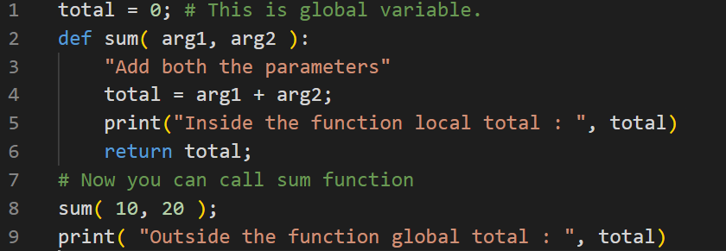
Python Function
Scope of Variables
Example:
This would produce the following result:
Inside the function local total : 30
Outside the function global total : 0

Slide 96
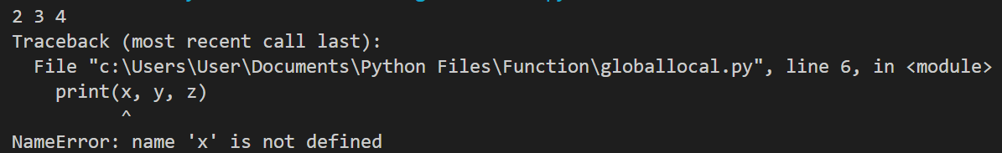
Local Variables
Python Function
Consider the following code:
def func1(x, y):
#local scope
z = 4
print(x, y, z)
func1(2, 3)
print(x, y, z)
Run
x, y, and z belong solely to the scope of func1(...) and can only be accessed inside func1(…); z is said to be local to func1(…), hence, referred to as a local variable

Slide 97
Global Variables
Python Function
Consider the following code
#global scope
x = 100
def func2():
print(x)
func2()
print(x)
Run
100
100
x is said to be a global variable since it is defined within the global scope of the program and can be, subsequently, accessed inside and outside func2()

Slide 98
Local vs. Global Variables
Python Function
Consider the following code
x = 100
def func3():
x = 20
print(x)
func3()
print(x)
Run
20
100
The global variable x is distinct from the local variable x inside func3()

Slide 99
Parameters vs. Global Variables
Python Function
Consider the following code
x = 100
def func4(x):
print(x)
func4(20)
print(x)
Run
20
100
The global variable x is distinct from the parameter x of func4(…)

Slide 100
The global Keyword
Python Function
Consider the following code
def func5():
global x
x = 20
print(x)
func5()
print(x)
Run
20
20
The global keyword binds variable x in the global scope; hence, can be accessed inside and outside func5()

Slide 101
Storing Functions in Module
Python’s Modules
In Python, a module is a file that contains Python code, including definitions, functions, and statements that can be used in other programs. Modules allow you to organize and reuse code across different projects.
To create a module and store your defined functions in it, you can follow these steps:
Create a new Python file with a .py extension. This will be your module file. For example, create a file called mymath.py.
Define your functions within the module file. In mymath.py, you can define the cube() and power() functions as follows: Program (mymath.py)
def cube(a):
return a**3
def power(a,n):
return a**n

Slide 102
Module Importing Techniques
Python’s Modules
Importing an entire module
Importing the entire module in the program file make available every function in the module. Remember that, module file and program file using module should be in the same location. Program (test1.py)
# importing an entire module
import mymath
n = mymath.cube(10)
print("Cube =", n)
n = mymath.power(5,4)
print("Power =", n)
Output
Cube = 1000
Power = 625

Slide 103
Module Importing Techniques
Python’s Modules
Importing a specific function
If you only need one or a few functions from a module, you can import them directly. This technique allows you to use the imported function(s) without needing to reference the module name.
Program (test2.py)
# importing a specific function
from mymath import cube
# module name is not required to call function
n = cube(10)
print("Cube =", n)

Slide 104
Module Importing Techniques
Python’s Modules
Giving a module an alias
It is common to give a module an alias to provide a shorter and more convenient name for referencing it in your program.
This is particularly useful when the module name is lengthy or prone to naming conflicts.
Allows you to use as a shorthand for referencing functions from the module.
Program (test3.py)
#importing module using alias
import mymath as m
n = m.cube(10)
print('Cube =' , n)
n = m.power(5,4)
print("Power =", n)
Output
Cube = 1000
Power = 625

